Slide 1

LOAD FLOW ANALYSIS AND FAULT ANALYSIS IN POWER SYSYTEM

Slide 2
CONTENET:
Introduction
Tools used
Circuit diagram
Working principle
Advantages and applications
Conclussion

Slide 3
INTROUDUCTION
The steady state operating conditions of a power system is balanced three phase ac But, due to sudden internal or external changes in the system, this condition is disrupted.
When the insulation the system fails at one or more points or a conducting object comes into contact with a live point, a short circuit or a fault occurs.
Faults may lead to fire breakout that consequently results into loss of life, loss of property, cut of supply in areas beyond the fault point in a transmission and distribution network leading to power blackouts and destruction of a system network.
All the above results into delayed development due to low gross product realised. Therefore, it is necessary to determine the values of system voltages and currents during three phase balanced fault conditions, so that protective devices may be located to detect and minimize the harmful effects.

Slide 4
Three phase balanced faults may be analysed using an equivalent single phase circuit. Normally, fault analysis is calculated in per-unit quantities as they provide solutions which are somewhat consistent over different voltage and power ratings, and operate on values of the order of unity.
The power world simulator tool can be employed to analyse the fault current distribution and bus voltages levels during unsymmetrical fault condition
The power world simulator tool is employed to analysis the three phase balanced fault of 6-bus power system model.
Although this system model is a relatively small and simple power system, this system works will assist students in understanding fault analysis.
The results of changes to the system can be seen quickly in power world, further
aiding students learning process and utility engineers.

Slide 5

TOOLS USED:
COMPUTER OR LAPTOP
POWER WORLD SIMULATOR SOFTWARE
IEEE 6BUS SYSETEM
LOAD FLOW ANALYASIS MODEL
FAULT ANALYSIS MODEL
RESULT AND REPORTING TOOLS

Slide 6
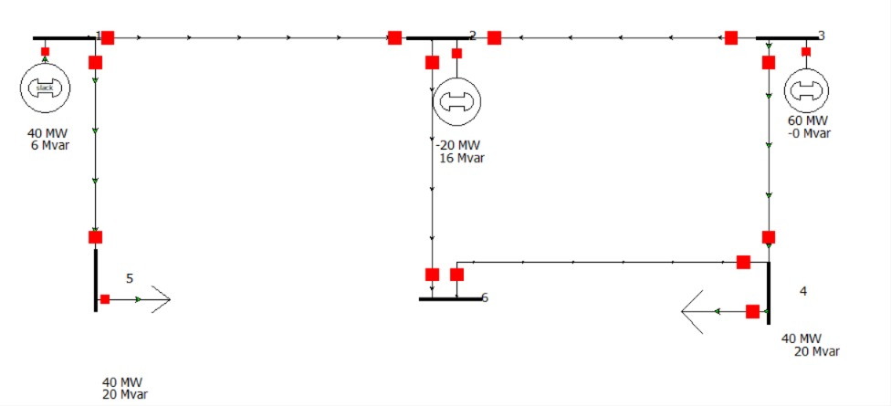
Circuit diagram:

Slide 7
WORKING PRINCIPLE
The Load Flow Analysis and Fault analysis of a IEEE 6-BUS Power System in Power World Simulator is carried out by creating a network model consisting of buses, generators, transmission lines, and loads. System data such as voltage levels, power generation, load demand, and line parameters are entered into the simulator.
First, Load Flow Analysis is performed under normal operating conditions. The simulator calculates bus voltages, voltage angles, active power flow, reactive power flow, and transmission losses throughout the network.
This helps evaluate the steady-state performance and operating condition of the power system.
Next, Fault Analysis is conducted by applying faults at selected buses or transmission lines.
The simulator computes fault currents, bus voltages during the fault, and the impact on the system. Different fault types such as single line-to-ground (LG), line-to-line (LL), double line-to-ground (LLG), and three-phase (LLL) faults can be analyzed.
The results obtained from both analyses are used to assess system stability, identify weak points in the network, and determine suitable protection schemes for reliable power system operation.

Slide 8
ADVANTAGES
Advantages of Load Flow Analysis
Determines bus voltages and voltage angles at all buses.
Calculates active and reactive power flow in transmission lines.
Identifies transmission line losses.
Helps in system planning, operation, and expansion.
Improves voltage regulation and system stability.
Advantages of Fault Analysis
Calculates fault currents accurately.
Helps in selecting suitable circuit breakers and relays.
Improves power system protection and reliability.
Reduces equipment damage during faults.
Enhances the safety and security of the power network.

Slide 9
APPLICATIONS:
Power System Planning – Used to design and expand electrical power networks.
Power System Operation – Monitors and analyzes system performance under normal conditions.
Protection System Design – Determines relay settings and circuit breaker ratings.
Fault Detection and Analysis – Identifies fault locations and fault current levels.
Voltage Stability Studies – Evaluates voltage profiles and system stability.
Transmission Network Analysis – Studies power flow and transmission losses.
Educational and Research Purposes – Widely used in engineering colleges and research projects.
Utility and Industrial Power Systems – Assists utilities in maintaining reliable and secure power supply.

Slide 10
CONCLUSION:
The Load Flow Analysis and Fault analysis of a IEEE 6-BUS Power System using Power World Simulator was successfully performed. Load flow analysis provided important information about bus voltages, power flows, and transmission losses under normal operating conditions. Fault analysis helped determine fault currents and the impact of various faults on the system. The study demonstrated the effectiveness of Power World Simulator in analyzing power system performance, identifying system weaknesses, and improving protection and reliability. Thus, load flow and fault analysis are essential tools for the safe, stable, and efficient operation of electrical power systems.

Slide 11
THANK YOU

